Slide 1
AIC EGERTON CHAPEL
SUNDAY
29.09. 2024

Slide 2
JAMES 3: 1 – 12 Psalm 19:14; 141:3

Slide 3
INTRODUCTION
September Theme
Phil. 2:3 – Humility
Our Nature is Putting on Masks - Hypocrisy

Slide 4
The Real Test of Humility is When Our Faith
Is STRETCHED by TESTS/SUFFERING/TRIALS
Is PRESSED by FAVOURITISM/PREJUDICE/PARTIALITY/WRONG ATTITUTES

Slide 5
The Real Test of Humility is When Our Faith
is EXPRESSED by the TONGUE

Slide 6
African Proverbs about the Tongue
“A cutting word is worse than a bowstring, a cut may heal, but the cut of the tongue does not”

Slide 7
African Proverbs about the Tongue
“The tongue weighs practically nothing but only a few people can hold it” -
Has no hammer but break bones
Has no fuel but it can set a house on fire

Slide 8
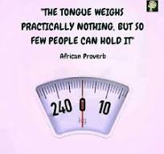

Slide 9
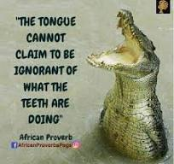

Slide 10
Western Proverb
‘The Tongue is so DEADLY that it had to be GUARDED by a contingent of 32 Heavily armed Soldiers’

Slide 11
Tomb stone (Epitaph) – “Beneath this stone lies a piece of clay who on 24th June 1960 began to hold her tongue” (Anonymous)

Slide 12
But at the same time
The TONGUE has been used in the past to change the Course of Human History – Families - ‘I DO’, used to Call people to Rally Behind a worthy course …

Slide 13
James in 3:1-12 gives a WARNING
An unchecked, unguarded, untamed TONGUE can ASSASINATE someone’s Character; can destroy a life, ruin a family a church, Nation

Slide 14
Spiritual Maturity develops through response to SUFFERING/TRIALS –James 1
Spiritual Maturity enhanced through our response to the WORD - James 2
Spiritual Maturity Evidenced by the use of the TONGUE - James 3:1-12

Slide 15
Prove the Genuineness of your Faith
By Mastering the TONGUE

Slide 16
James had spoken about the Tongue EARLIER
1:19 – Be slow to speak …
1:26 – Religious? … Keep a tight rein on the Tongue
2:14 – TALKS (claims – but No Deeds
4:1-17 – Quarrels, Battles & Boasting

Slide 17
JAMES 3:1-12; PSALM 19:14 & 141:3
STRONG WARNING FOR TEACHERS: Not Many of you should presume to be teachers – He is not saying it is wrong to desire TEACHING or LEADERSHIP – Because the Tongue Affects others
1Timothy 1:1-7; 2Timothy 3:16-17; 4:2; Colossians 1:28-29 –Teaching, Preaching, Proclaiming, Correct etc
James is not Condemning teaching nor promoting silence BUT PROMOTING CONTROL - Why?

Slide 18
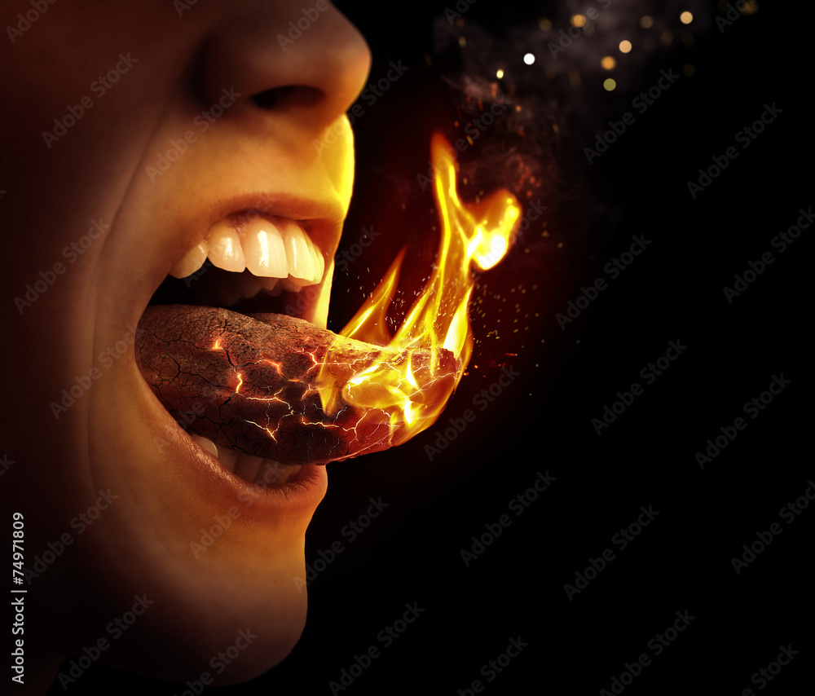
The TONGUE is in a wet place and is likely to slip

Slide 19
Cont’d
James gives THREE facts about the Human TONGUE

Slide 20
James 3:1-12 -The TONGUE Is
SMALL But POWERFUL – Vv. 3 – 5 (Direct &Defiles)
A Horse – Bridle
A ship – Radar
A fire - spark

Slide 21
James 3:1-12 -The TONGUE Is
2. NECESSARY But DANGEROUS – Vv. 6 – 8 (Defies & Destroys)
Fire
Beast
Poison
Very Hard to Control

Slide 22
James 3:1-12 -The TONGUE Is
3. HELPFUL But INCONSISTENT –
Vv. 9 – 12 (Displays)
Blessing (Praises) & Curses
Fresh water & Salt water
Olives and Grapes

Slide 23
James 3:1-12 -The TONGUE Is
Must Be TAMED
How?

Slide 24
Winning the Battle of the TONGUE = Winning ALL of our Battles – James 3:2

Slide 25
Cont’d
READ – Matthew 15:15-19
The CONDITION of our HEARTS

Slide 26
Cont’d
Philippians 4:8
THINK

Slide 27
THINK before TALKING
Is it True?
Is it Helpful?
Is it Inspiring?
Is it Necessary?
Is it Kind?

Slide 28
Conclusion
How have you been using your TONGUE?
Build or Destroy?
Encourage or Discourage
James Reminds – LET US TAME OUR TONGUES

